Slide 1
Blue Prism
Training & Workshop
October 24, 2023

Slide 2


Slide 3
SS&C Completes Acquisition of Blue Prism Group PLC
SS&C Mission & Core Values

Slide 4

Robotic Process Automation ( RPA )
Robotic process automation (RPA), also known as software robotics, is a form of software used to automate repetitive, rule-based tasks. It often mimics back-office tasks of human workers, such as extracting data, filling in forms, moving files, etc.
There are multiple benefits of RPA, including:
Less coding
Rapid cost savings
Higher customer satisfaction
Improved employee morale
Better accuracy and compliance
Existing systems remain in place

Slide 5

Prepare employees’ compensation by the end of each month.
Enter new employees’ data (bank accounts, tax identification no.)
4 DAYS
1 DAY
Maintain and keep a list of employees updated.
2 DAYS
Check if all employees follow time attendance policy.
3 DAYS

Slide 6

Prepare employees’ compensation by the end of each month.
Enter new employees’ data (bank accounts, tax identification no.)
1 MIN
1 MIN
Maintain and keep a list of employees updated.
1 MIN
Check if all employees follow time attendance policy.
1 MIN

Slide 7

To let a robot do the repetitive tasks for us, it is human’s responsibility to give clear instructions to the robot.
There are many RPA tools that allow us to create an instructions for a robot.
One of them is Blue Prism.
Blue Prism community:
https://community.blueprism.com/home
Blue Prism official documentation:
https://bpdocs.blueprism.com/bp-7-2/en-us/home.htm

Slide 8

5 + 2 = ?

Slide 9
I am an expert in
C programming language.
#include <stdio.h>
int addition(int x, int y)
{
int z = x + y;
return z;
}
int main()
{
int z = addition(5, 2);
printf(“5 + 2 = %i”, z);
}
5 + 2 = ?
5 + 2 = 7

Slide 10
I am an expert in
Java programming language.
class Addition {
public static int addition(int x, int y) {
int z = x + y;
return z;
}
public static void main(String[] args) {
int z = addition(5, 2);
System.out.println(“5 + 2 = ” + z);
}
}
5 + 2 = ?
5 + 2 = 7

Slide 11
I am an expert in
Python programming language.
def addition(x, y):
z = x + y
return z
if __name__ == “__main__”:
z = addition(5, 2)
print(“5 + 2 =”, z)
5 + 2 = ?
5 + 2 = 7

Slide 12
I don’t have any experience in programming language.
…
5 + 2 = ?

Slide 13
I don’t have any experience in programming language.
I can use Blue Prism !
Start
5 + 2 = ?
5 + 2
5 + 2 = 7
End

Slide 14
Let’s explore Blue Prism !

Slide 15
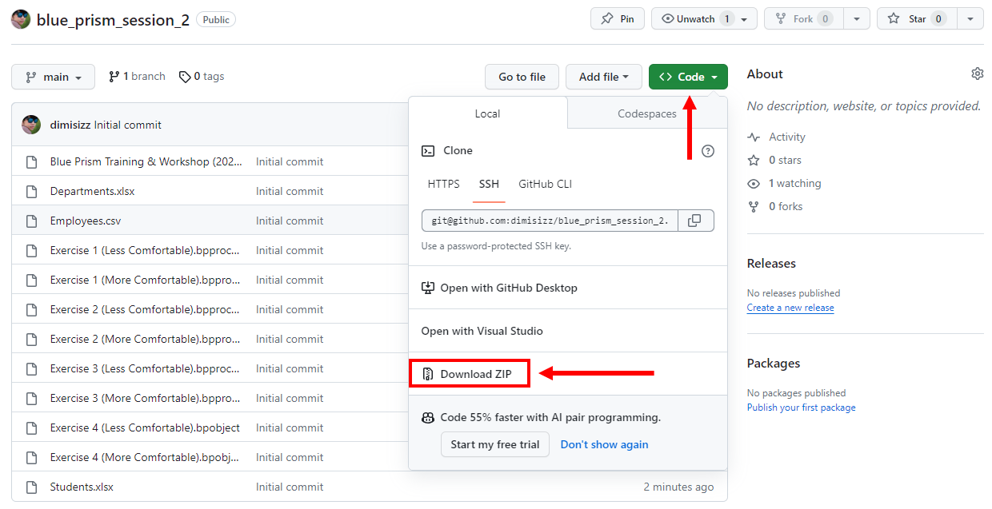
https://github.com/dimisizz/blue_prism_session_2

Slide 16
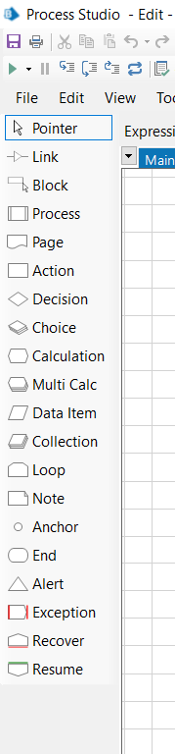
A Blue Prism process consist of multiple “Stages”.
These stages are like the tools that help you to create workflow.
Let’s look at each of them one by one and see examples how to use them.

Slide 17
Pointer
Link
Block
Process
Page
Action
Decision
Choice
Calculation
Multi Calc
Data Item
Collection
Loop
Note
Anchor
End
Alert
Exception
Recover
Resume
Data Item is a box that contains data. It could be text, number, flag, etc.
Start
Add title name
Name
Alice
Add 10 to Age
Age
15
Change Married from False to True
Married
True
End

Slide 18
Pointer
Link
Block
Process
Page
Action
Decision
Choice
Calculation
Multi Calc
Data Item
Collection
Loop
Note
Anchor
End
Alert
Exception
Recover
Resume
Calculation allows you to play around with data contained in Data Item.
Start
Add title name
Name
Alice
Add 10 to Age
Age
15
Change Married from False to True
Married
True
End

Slide 19
Pointer
Link
Block
Process
Page
Action
Decision
Choice
Calculation
Multi Calc
Data Item
Collection
Loop
Note
Anchor
End
Alert
Exception
Recover
Resume
Link connects elements to each other.
Start
Add title name
Name
Alice
Add 10 to Age
Age
15
Change Married from False to True
Married
True
End

Slide 20
Pointer
Link
Block
Process
Page
Action
Decision
Choice
Calculation
Multi Calc
Data Item
Collection
Loop
Note
Anchor
End
Alert
Exception
Recover
Resume
Multi Calc allows you to play around with multiple expressions.
Start
Start
Add title name
Name
Alice
Add title name, increase age, change Married to True
Add 10 to Age
Age
15
Change Married from False to True
Married
True
End
End

Slide 21
Pointer
Link
Block
Process
Page
Action
Decision
Choice
Calculation
Multi Calc
Data Item
Collection
Loop
Note
Anchor
End
Alert
Exception
Recover
Resume
End allows you to end the current process.
You can have multiple Ends in a process.
Start
Add title name
Name
Alice
Add title name, increase age, change Married to True
Add 10 to Age
Age
15
Change Married from False to True
Married
True
End
End

Slide 22
Pointer
Link
Block
Process
Page
Action
Decision
Choice
Calculation
Multi Calc
Data Item
Collection
Loop
Note
Anchor
End
Alert
Exception
Recover
Resume
End allows you to end the current process.
You can have multiple Ends in a process.
Start
Add title name
Name
Alice
Add title name, increase age, change Married to True
Add 10 to Age
Age
15
Change Married from False to True
Married
True
End
End

Slide 23
Pointer
Link
Block
Process
Page
Action
Decision
Choice
Calculation
Multi Calc
Data Item
Collection
Loop
Note
Anchor
End
Alert
Exception
Recover
Resume
Note allows you to edit the note. You can add some useful descriptions.
Some useful descriptions…

Slide 24


Pointer
Link
Block
Process
Page
Action
Decision
Choice
Calculation
Multi Calc
Data Item
Collection
Loop
Note
Anchor
End
Alert
Exception
Recover
Resume
Pointer turns your cursor back to the normal stage
where you can drag, drop, and move elements in a flow.

Slide 25
Pointer ✓
Link ✓
Block
Process
Page
Action
Decision
Choice
Calculation ✓
Multi Calc ✓
Data Item ✓
Collection
Loop
Note ✓
Anchor
End ✓
Alert
Exception
Recover
Resume
We have seen the concept of 7 stages.
( Pointer, Link, Calculation, Multi Calc, Data Item, Note, End )
13 more to go !

Slide 26
Takeaways
- Data Item is a box that contains some data.
- Data Item can contain multiple types of data.
For example: Text, Number, Flag, etc.
- We can access data in Data Item using square brackets around Data Item name.
For example: [Name], [Age], [Married], etc.
- To play around with data in Data Item, we can use Calculation.
- Instead of using Calculation, we can use Multi Calc to do multiple calculations.
- Calculation and Multi Calc need a place to store their output.
- A process can have multiple Ends but can have only one Start.
- We can use Note to add some useful descriptions anywhere in a flow.

Slide 27
Exercise 1
( Less Comfortable )

Slide 28
The Data Item First name contains the text “ mi Ke ”
The Data Item Last name contains the text “ s M i th ”
When the flow runs, the Data Item Full name should contain the text “MIKE SMITH”
Start
First name
mi Ke
How ?
Last name
s M i th
Full name
End

Slide 29
Exercise 1
( More Comfortable )

Slide 30
When the flow runs, the Data Item Average should contain the 2 decimal places average value of the seven numbers.
First number
40
Second number
21
Start
Third number
55
How ?
Fourth number
21
Average
Fifth number
48
Sixth number
13
End
Seventh number
72
Average should be 38.57

Slide 31

BREAK TIME
10:20 – 10:30

Slide 32
Pointer
Link
Block
Process
Page
Action
Decision
Choice
Calculation
Multi Calc
Data Item
Collection
Loop
Note
Anchor
End
Alert
Exception
Recover
Resume
Decision allows you to perform different actions depending on some conditions.
If age is between 0 and 20, then Minor.
If age is between 20 and 60, then Adult.
If age is greater than or equal to 60, then Elderly.

Slide 33
Pointer
Link
Block
Process
Page
Action
Decision
Choice
Calculation
Multi Calc
Data Item
Collection
Loop
Note
Anchor
End
Alert
Exception
Recover
Resume
Decision allows you to perform different actions depending on some conditions.
If age is between 0 and 20, then Minor.
If age is between 20 and 60, then Adult.
If age is greater than or equal to 60, then Elderly.
If age is less than 20, then Minor.
else if age is less than 60, then Adult.
else if age is greater than or equal to 60, then Elderly.
Yes
Age is less than 20
No
Yes
Age is less than 60
No
Minor
Age is greater than or equal to 60
Adult
Yes
Elderly
No
End

Slide 34
Pointer
Link
Block
Process
Page
Action
Decision
Choice
Calculation
Multi Calc
Data Item
Collection
Loop
Note
Anchor
End
Alert
Exception
Recover
Resume
Decision allows you to perform different actions depending on some conditions.
If age is between 0 and 20, then Minor.
If age is between 20 and 60, then Adult.
If age is greater than or equal to 60, then Elderly.
If age is less than 20, then Minor.
else if age is less than 60, then Adult.
else if age is greater than or equal to 60, then Elderly.
If age is less than 20, then Minor.
else if age is less than 60, then Adult.
else Elderly.
Yes
Age is less than 20
No
Yes
Age is less than 60
No
Minor
Adult
Elderly
End

Slide 35
Pointer
Link
Block
Process
Page
Action
Decision
Choice
Calculation
Multi Calc
Data Item
Collection
Loop
Note
Anchor
End
Alert
Exception
Recover
Resume
Anchor allows links to be placed at right angles around the process.
Age is less than 60
Age is less than 60
Adult
Elderly
Adult
Elderly
End
End

Slide 36
Pointer
Link
Block
Process
Page
Action
Decision
Choice
Calculation
Multi Calc
Data Item
Collection
Loop
Note
Anchor
End
Alert
Exception
Recover
Resume
Choice allows you to perform different actions based on values.
Yes
Title name is “Mr.”
No
If title name is “Mr.”, then Male.
If title name is “Ms.”, then Female.
If title name is “Mrs.”, then Female.
Otherwise, No data.
Yes
Title name is “Ms.”
No
Male
Title name is “Mrs.”
Female
Yes
Female
No
End

Slide 37
Pointer
Link
Block
Process
Page
Action
Decision
Choice
Calculation
Multi Calc
Data Item
Collection
Loop
Note
Anchor
End
Alert
Exception
Recover
Resume
Choice allows you to perform different actions based on values.
Choice
If title name is “Mr.”, then Male.
If title name is “Ms.”, then Female.
If title name is “Mrs.”, then Female.
Otherwise, No data.
Mr.
Male
Ms.
Female
Mrs.
Female
Otherwise
No data
End

Slide 38
Pointer
Link
Block
Process
Page
Action
Decision
Choice
Calculation
Multi Calc
Data Item
Collection
Loop
Note
Anchor
End
Alert
Exception
Recover
Resume
Collection allows you to store data as a table.
Name
Alice
Age
15
Married
False
Name
Bob
Age
40
Married
True
Name
Charlie
Age
65
Married
True

Slide 39
Pointer
Link
Block
Process
Page
Action
Decision
Choice
Calculation
Multi Calc
Data Item
Collection
Loop
Note
Anchor
End
Alert
Exception
Recover
Resume
Collection allows you to store data as a table.
Name
Alice
Age
15
Married
False
People
Row 1 of 3
Name
Bob
Age
40
Married
True
Name | Age | Married
Alice | 15 | False
Bob | 40 | True
Charlie | 65 | True
Name
Charlie
Age
65
Married
True

Slide 40
Pointer
Link
Block
Process
Page
Action
Decision
Choice
Calculation
Multi Calc
Data Item
Collection
Loop
Note
Anchor
End
Alert
Exception
Recover
Resume
Collection allows you to store data as a table.
Name
Alice
Age
15
Married
False
People
Row 1 of 3
Name | Age | Married
Alice | 15 | False
Bob | 40 | True
Charlie | 65 | True
[Name]
[Age]
[Married]
[People.Name]
[People.Age]
[People.Married]

Slide 41
Pointer
Link
Block
Process
Page
Action
Decision
Choice
Calculation
Multi Calc
Data Item
Collection
Loop
Note
Anchor
End
Alert
Exception
Recover
Resume
Loop allows you to access the contents of a collection.
Start
Loop Start
People
Row 1 of 3
Stage of Life = Adult
Name | Age | Married | Stage of Life
Alice | 15 | False
Bob | 40 | True
Charlie | 65 | True
Loop End
End

Slide 42
Pointer
Link
Block
Process
Page
Action
Decision
Choice
Calculation
Multi Calc
Data Item
Collection
Loop
Note
Anchor
End
Alert
Exception
Recover
Resume
Loop allows you to access the contents of a collection.
Start
Loop Start
People
Row 1 of 3
Stage of Life = Adult
Name | Age | Married | Stage of Life
Alice | 15 | False | Adult
Bob | 40 | True
Charlie | 65 | True
Loop End
End

Slide 43
Pointer
Link
Block
Process
Page
Action
Decision
Choice
Calculation
Multi Calc
Data Item
Collection
Loop
Note
Anchor
End
Alert
Exception
Recover
Resume
Loop allows you to access the contents of a collection.
Start
Loop Start
People
Row 2 of 3
Stage of Life = Adult
Name | Age | Married | Stage of Life
Alice | 15 | False | Adult
Bob | 40 | True | Adult
Charlie | 65 | True
Loop End
End

Slide 44
Pointer
Link
Block
Process
Page
Action
Decision
Choice
Calculation
Multi Calc
Data Item
Collection
Loop
Note
Anchor
End
Alert
Exception
Recover
Resume
Loop allows you to access the contents of a collection.
Start
Loop Start
People
Row 3 of 3
Stage of Life = Adult
Name | Age | Married | Stage of Life
Alice | 15 | False | Adult
Bob | 40 | True | Adult
Charlie | 65 | True | Adult
Loop End
End

Slide 45
Pointer
Link
Block
Process
Page
Action
Decision
Choice
Calculation
Multi Calc
Data Item
Collection
Loop
Note
Anchor
End
Alert
Exception
Recover
Resume
Loop allows you to access the contents of a collection.
Start
Loop Start
People
Row 1 of 3
Yes
Age < 20
No
Stage of Life
=
Minor
Yes
Age < 60
No
Name | Age | Married | Stage of Life
Alice | 15 | False
Bob | 40 | True
Charlie | 65 | True
Stage of Life
=
Adult
Stage of Life
=
Elderly
Loop End
End

Slide 46
Pointer
Link
Block
Process
Page
Action
Decision
Choice
Calculation
Multi Calc
Data Item
Collection
Loop
Note
Anchor
End
Alert
Exception
Recover
Resume
Loop allows you to access the contents of a collection.
Start
Loop Start
People
Row 1 of 3
Yes
Age < 20
No
Stage of Life
=
Minor
Yes
Age < 60
No
Name | Age | Married | Stage of Life
Alice | 15 | False | Minor
Bob | 40 | True
Charlie | 65 | True
Stage of Life
=
Adult
Stage of Life
=
Elderly
Loop End
End

Slide 47
Pointer
Link
Block
Process
Page
Action
Decision
Choice
Calculation
Multi Calc
Data Item
Collection
Loop
Note
Anchor
End
Alert
Exception
Recover
Resume
Loop allows you to access the contents of a collection.
Start
Loop Start
People
Row 2 of 3
Yes
Age < 20
No
Stage of Life
=
Minor
Yes
Age < 60
No
Name | Age | Married | Stage of Life
Alice | 15 | False | Minor
Bob | 40 | True | Adult
Charlie | 65 | True
Stage of Life
=
Adult
Stage of Life
=
Elderly
Loop End
End

Slide 48
Pointer
Link
Block
Process
Page
Action
Decision
Choice
Calculation
Multi Calc
Data Item
Collection
Loop
Note
Anchor
End
Alert
Exception
Recover
Resume
Loop allows you to access the contents of a collection.
Start
Loop Start
People
Row 3 of 3
Yes
Age < 20
No
Stage of Life
=
Minor
Yes
Age < 60
No
Name | Age | Married | Stage of Life
Alice | 15 | False | Minor
Bob | 40 | True | Adult
Charlie | 65 | True | Elderly
Stage of Life
=
Adult
Stage of Life
=
Elderly
Loop End
End

Slide 49
Pointer
Link
Block
Process
Page
Action
Decision ✓
Choice ✓
Calculation
Multi Calc
Data Item
Collection ✓
Loop ✓
Note
Anchor ✓
End
Alert
Exception
Recover
Resume
We have seen the concept of 5 more stages.
( Decision, Choice, Collection, Loop, Anchor )
8 more to go !

Slide 50
Takeaways
- We can use Decision to perform actions based on conditions.
- We can use Anchor for domestic purpose.
- We can use Choice to perform actions based on conditions identified by value.
- We can use Collection to store data as a table.
- We can access data in Collection using a period.
For example: [People.Name], [People.Age], [People.Married], etc.
- We can use Loop to access rows of Collection.

Slide 51
Exercise 2
( Less Comfortable )

Slide 52
Title | First Name | Last Name | Full Name | Gender | Year of Birth | Age | IsMinor
Mr. | Maximillian | Glenn |  |  | 2000
Mrs. | Annabella | Doyle |  |  | 1986
Ms. | Jennie | Guzman |  |  | 2012
Mr. | Brendan | Payne |  |  | 2005
Mrs. | Sallie | Pugh |  |  | 1993
Full Name should be this format:
→ LASTNAME, Firstname
If Title is “Mr.”, Gender should be “Male”.
If Title is “Ms.”, Gender should be “Female”.
If Title is “Mrs.”, Gender should be “Female”.
Age should be Year of Birth subtracted from 2023.
If Age is less than 20, IsMinor should be True.
Otherwise, IsMinor should be False.
Title | First Name | Last Name | Full Name | Gender | Year of Birth | Age | IsMinor
Mr. | Maximillian | Glenn | GLENN, Maximillian | Male | 2000 | 23 | False
Mrs. | Annabella | Doyle | DOYLE, Annabella | Female | 1986 | 37 | False
Ms. | Jennie | Guzman | GUZMAN, Jennie | Female | 2012 | 11 | True
Mr. | Brendan | Payne | PAYNE, Brendan | Male | 2005 | 18 | True
Mrs. | Sallie | Pugh | PUGH, Sallie | Female | 1993 | 30 | False

Slide 53
Exercise 2
( More Comfortable )

Slide 54
Name | Current Salary | Promotion Code | Adjusted Amount | New Salary | Rounded New Salary
Alice | 32434.54 | I7
Bob | 27971.98 | D3
Charlie | 19600.12 | I9
David | 39100.73 | D4
Emma | 28300.46 | I6
Promotion Code
“I7” means salary is increased by 7%
“D3” means salary is decreased by 3%
Adjusted Amount should be positive or negative number after applying to Promotion Code. Decimal places should be 2.
New Salary should be an addition of Current Salary and Adjusted Amount. Decimal places should be 2.
Name | Current Salary | Promotion Code | Adjusted Amount | New Salary | Rounded New Salary
Alice | 32434.54 | I7 | 2270.42 | 34704.96 | 34705
Bob | 27971.98 | D3 | -839.16 | 27132.82 | 27133
Charlie | 19600.12 | I9 | 1764.01 | 21364.13 | 21364
David | 39100.73 | D4 | -1564.03 | 37536.70 | 37537
Emma | 28300.46 | I6 | 1698.03 | 29998.49 | 29998
Rounded New Salary should be New Salary without decimal places.

Slide 55

LUNCH TIME
12:00 – 13:00

Slide 56
Pointer
Link
Block
Process
Page
Action
Decision
Choice
Calculation
Multi Calc
Data Item
Collection
Loop
Note
Anchor
End
Alert
Exception
Recover
Resume

Slide 57

Pointer
Link
Block
Process
Page
Action
Decision
Choice
Calculation
Multi Calc
Data Item
Collection
Loop
Note
Anchor
End
Alert
Exception
Recover
Resume
Self-Study !
https://bpdocs.blueprism.com/bp-7-2/en-us/stage-types.htm

Slide 58
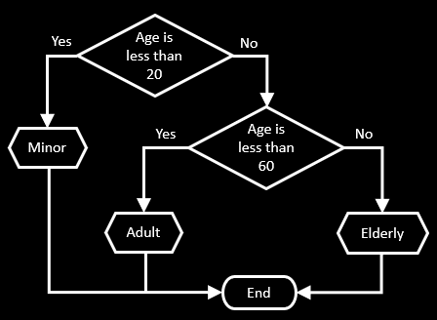
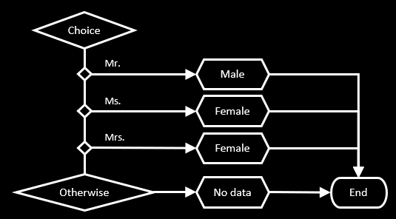
Pointer
Link
Block
Process
Page
Action
Decision
Choice
Calculation
Multi Calc
Data Item
Collection
Loop
Note
Anchor
End
Alert
Exception
Recover
Resume
If you have too many elements in a flow, you can break them into small pieces (pages). Page allows you to run flows in other pages.
Main Page

Slide 59
Pointer
Link
Block
Process
Page
Action
Decision
Choice
Calculation
Multi Calc
Data Item
Collection
Loop
Note
Anchor
End
Alert
Exception
Recover
Resume
If you have too many elements in a flow, you can break them into small pieces (pages). Page allows you to run flows in other pages.
Main Page
Get Stage of Life
Get Gender

Slide 60
Pointer
Link
Block
Process
Page
Action
Decision
Choice
Calculation
Multi Calc
Data Item
Collection
Loop
Note
Anchor
End
Alert
Exception
Recover
Resume
If you have too many elements in a flow, you can break them into small pieces (pages). Page allows you to run flows in other pages.
Main Page
Get Stage of Life
Start
Get Stage of Life
Get Gender
Get Gender
End

Slide 61
Pointer
Link
Block
Process
Page
Action
Decision
Choice
Calculation
Multi Calc
Data Item
Collection
Loop
Note
Anchor
End
Alert
Exception
Recover
Resume
Process allows you to run another processes.
Process One
Start
Do something…
End

Slide 62
Pointer
Link
Block
Process
Page
Action
Decision
Choice
Calculation
Multi Calc
Data Item
Collection
Loop
Note
Anchor
End
Alert
Exception
Recover
Resume
Process allows you to run another processes.
Process One
Process Two
Start
Start
Do something…
Run Process One
End
End

Slide 63
Pointer
Link
Block
Process
Page
Action
Decision
Choice
Calculation
Multi Calc
Data Item
Collection
Loop
Note
Anchor
End
Alert
Exception
Recover
Resume
Recover allows you to prevent the process to stop. In other words, you can do something useful instead of letting the entire process to stop.
Error Message 1
Start
Add title name
Name
Alice
Add “ABC” to Age
Age
15
Recover
Move error message to
Error Message 1
Change Married from False to True
Married
False
End

Slide 64
Pointer
Link
Block
Process
Page
Action
Decision
Choice
Calculation
Multi Calc
Data Item
Collection
Loop
Note
Anchor
End
Alert
Exception
Recover
Resume
Resume allows you to continue the process after handling error.
Error Message 1
Start
Add title name
Name
Alice
Add “ABC” to Age
Age
15
Recover
Move error message to
Error Message 1
Change Married from False to True
Married
False
Resume
End
End

Slide 65
Pointer
Link
Block
Process
Page
Action
Decision
Choice
Calculation
Multi Calc
Data Item
Collection
Loop
Note
Anchor
End
Alert
Exception
Recover
Resume
Block allows you to group some actions into a specific area.
Error Message 1
Error Message 2
Start
Add title name
Name
Alice
Add “ABC” to Age
Age
15
Recover
Move error message to
Error Message 1
Change Married from False to “ABC”
Married
False
Recover
Resume
Move error message to
Error Message 2
End
End
Resume

Slide 66
Pointer
Link
Block
Process
Page
Action
Decision
Choice
Calculation
Multi Calc
Data Item
Collection
Loop
Note
Anchor
End
Alert
Exception
Recover
Resume
Block allows you to group some actions into a specific area.
Error Message 1
Error Message 2
Start
Add title name
Name
Alice
Add “ABC” to Age
Age
15
Recover
Move error message to
Error Message 1
Change Married from False to “ABC”
Married
False
Recover
Resume
Move error message to
Error Message 2
End
End
Resume

Slide 67
Pointer
Link
Block
Process
Page
Action
Decision
Choice
Calculation
Multi Calc
Data Item
Collection
Loop
Note
Anchor
End
Alert
Exception
Recover
Resume
The Exception allows you to report an error message and stop the process.
Age is less than zero
Yes
Exception
Start
No
Age is not integer
Yes
Exception
No
Yes
Age is less than 20
No
Yes
Age is less than 60
No
Minor
Adult
Elderly
End

Slide 68
Pointer
Link
Block
Process
Page
Action
Decision
Choice
Calculation
Multi Calc
Data Item
Collection
Loop
Note
Anchor
End
Alert
Exception
Recover
Resume
The Alert allows you to set show message when you run a process.
Start
Do something…
Alert
End

Slide 69

Pointer
Link
Block
Process
Page
Action
Decision
Choice
Calculation
Multi Calc
Data Item
Collection
Loop
Note
Anchor
End
Alert
Exception
Recover
Resume
The Action allows you to use actions from VBOs.
What is VBO ?
What is actions from VBO ?

Slide 70
Visual Business Object
( VBO )

Slide 71
MS Word
File Management
Copy Text
Paste Image
Highlight Text
Find Text
Save as PDF
…
Create Directory
Delete Directory
Copy File
Delete File
Write Text File
Move File
…
MS Excel
Add Row
Delete Row
Add Column
Delete Column
Add Worksheet
…
Decision
Choice
Calculation
Multi Calc
Collection
Loop
…
Collection Manipulation
Append Field
Filter Collection
Remove Empty Rows
…
MS Outlook Email
Send Email
Reply to Email
Forward Email
Delete Email
Mark Email as Unread
…

Slide 72
MS Word
VBO
VBO
File Management
Copy Text
Paste Image
Highlight Text
Find Text
Save as PDF
…
Create Directory
Delete Directory
Copy File
Delete File
Write Text File
Move File
…
VBO
MS Excel
Add Row
Delete Row
Add Column
Delete Column
Add Worksheet
…
Decision
Choice
Calculation
Multi Calc
Collection
Loop
…
VBO
Collection Manipulation
Append Field
Filter Collection
Remove Empty Rows
…
MS Outlook Email
Send Email
Reply to Email
Forward Email
Delete Email
Mark Email as Unread
…
VBO

Slide 73
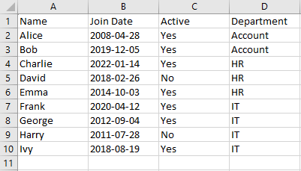
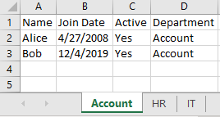
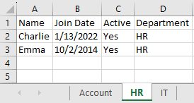
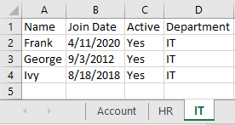
Employees.csv
Departments.xlsx

Slide 74
Step 1 : Get data from Employees.csv
Step 2 : Remove inactive employees
Employees.csv
Step 3 : Get a list of Account employees
Step 4 : Get a list of HR employees
Step 5 : Get a list of IT employees
Step 6 : Open Departments.xlsx
Step 7 : Write data in Step 3 into worksheet “Account”
Step 8 : Write data in Step 4 into worksheet “HR”
Departments.xlsx
Step 9 : Write data in Step 5 into worksheet “IT”
Step 10 : Save Departments.xlsx
Step 11 : Close Departments.xlsx

Slide 75
Step 1 : Get data from Employees.csv
Step 2 : Remove inactive employees
Step 3 : Get a list of Account employees
Step 4 : Get a list of HR employees
Step 5 : Get a list of IT employees
Step 6 : Open Departments.xlsx
Step 7 : Write data in Step 3 into worksheet “Account”
Step 8 : Write data in Step 4 into worksheet “HR”
Step 9 : Write data in Step 5 into worksheet “IT”
Step 10 : Save Departments.xlsx
Step 11 : Close Departments.xlsx

Slide 76
Step 1 : Get data from Employees.csv
Step 2 : Remove inactive employees
Employees.csv
Step 3 : Get a list of Account employees
Step 4 : Get a list of HR employees
Step 5 : Get a list of IT employees
Step 6 : Open Departments.xlsx
Step 7 : Write data in Step 3 into worksheet “Account”
Step 8 : Write data in Step 4 into worksheet “HR”
Step 9 : Write data in Step 5 into worksheet “IT”
Step 10 : Save Departments.xlsx
Step 11 : Close Departments.xlsx

Slide 77
Step 1 : Get data from Employees.csv
Step 2 : Remove inactive employees
Employees.csv
Step 3 : Get a list of Account employees
Step 4 : Get a list of HR employees
Step 5 : Get a list of IT employees
Step 6 : Open Departments.xlsx
Step 7 : Write data in Step 3 into worksheet “Account”
Step 8 : Write data in Step 4 into worksheet “HR”
Step 9 : Write data in Step 5 into worksheet “IT”
Step 10 : Save Departments.xlsx
Step 11 : Close Departments.xlsx

Slide 78
Step 1 : Get data from Employees.csv
Step 2 : Remove inactive employees
Employees.csv
Step 3 : Get a list of Account employees
Step 4 : Get a list of HR employees
Step 5 : Get a list of IT employees
Name | Join Date | Active | Department
Alice | 2008-04-28 | Yes | Account
Bob | 2019-12-05 | Yes | Account
Step 6 : Open Departments.xlsx
Step 7 : Write data in Step 3 into worksheet “Account”
Step 8 : Write data in Step 4 into worksheet “HR”
Step 9 : Write data in Step 5 into worksheet “IT”
Step 10 : Save Departments.xlsx
Step 11 : Close Departments.xlsx

Slide 79
Step 1 : Get data from Employees.csv
Step 2 : Remove inactive employees
Employees.csv
Step 3 : Get a list of Account employees
Step 4 : Get a list of HR employees
Step 5 : Get a list of IT employees
Name | Join Date | Active | Department
Alice | 2008-04-28 | Yes | Account
Bob | 2019-12-05 | Yes | Account
Step 6 : Open Departments.xlsx
Step 7 : Write data in Step 3 into worksheet “Account”
Name | Join Date | Active | Department
Charlie | 2022-01-14 | Yes | HR
Emma | 2014-10-03 | Yes | HR
Step 8 : Write data in Step 4 into worksheet “HR”
Step 9 : Write data in Step 5 into worksheet “IT”
Step 10 : Save Departments.xlsx
Step 11 : Close Departments.xlsx

Slide 80
Step 1 : Get data from Employees.csv
Step 2 : Remove inactive employees
Employees.csv
Step 3 : Get a list of Account employees
Step 4 : Get a list of HR employees
Step 5 : Get a list of IT employees
Name | Join Date | Active | Department
Alice | 2008-04-28 | Yes | Account
Bob | 2019-12-05 | Yes | Account
Step 6 : Open Departments.xlsx
Step 7 : Write data in Step 3 into worksheet “Account”
Name | Join Date | Active | Department
Charlie | 2022-01-14 | Yes | HR
Emma | 2014-10-03 | Yes | HR
Step 8 : Write data in Step 4 into worksheet “HR”
Step 9 : Write data in Step 5 into worksheet “IT”
Name | Join Date | Active | Department
Frank | 2020-04-12 | Yes | IT
George | 2012-09-04 | Yes | IT
Ivy | 2018-08-19 | Yes | IT
Step 10 : Save Departments.xlsx
Step 11 : Close Departments.xlsx

Slide 81
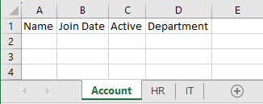
Step 1 : Get data from Employees.csv
Step 2 : Remove inactive employees
Departments.xlsx
Step 3 : Get a list of Account employees
Step 4 : Get a list of HR employees
Step 5 : Get a list of IT employees
Name | Join Date | Active | Department
Alice | 2008-04-28 | Yes | Account
Bob | 2019-12-05 | Yes | Account
Step 6 : Open Departments.xlsx
Step 7 : Write data in Step 3 into worksheet “Account”
Name | Join Date | Active | Department
Charlie | 2022-01-14 | Yes | HR
Emma | 2014-10-03 | Yes | HR
Step 8 : Write data in Step 4 into worksheet “HR”
Step 9 : Write data in Step 5 into worksheet “IT”
Name | Join Date | Active | Department
Frank | 2020-04-12 | Yes | IT
George | 2012-09-04 | Yes | IT
Ivy | 2018-08-19 | Yes | IT
Step 10 : Save Departments.xlsx
Step 11 : Close Departments.xlsx

Slide 82
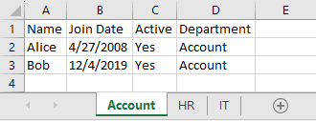
Step 1 : Get data from Employees.csv
Step 2 : Remove inactive employees
Departments.xlsx
Step 3 : Get a list of Account employees
Step 4 : Get a list of HR employees
Step 5 : Get a list of IT employees
Name | Join Date | Active | Department
Alice | 2008-04-28 | Yes | Account
Bob | 2019-12-05 | Yes | Account
Step 6 : Open Departments.xlsx
Step 7 : Write data in Step 3 into worksheet “Account”
Name | Join Date | Active | Department
Charlie | 2022-01-14 | Yes | HR
Emma | 2014-10-03 | Yes | HR
Step 8 : Write data in Step 4 into worksheet “HR”
Step 9 : Write data in Step 5 into worksheet “IT”
Name | Join Date | Active | Department
Frank | 2020-04-12 | Yes | IT
George | 2012-09-04 | Yes | IT
Ivy | 2018-08-19 | Yes | IT
Step 10 : Save Departments.xlsx
Step 11 : Close Departments.xlsx

Slide 83
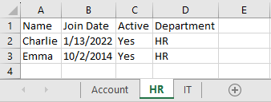
Step 1 : Get data from Employees.csv
Step 2 : Remove inactive employees
Departments.xlsx
Step 3 : Get a list of Account employees
Step 4 : Get a list of HR employees
Step 5 : Get a list of IT employees
Step 6 : Open Departments.xlsx
Step 7 : Write data in Step 3 into worksheet “Account”
Name | Join Date | Active | Department
Charlie | 2022-01-14 | Yes | HR
Emma | 2014-10-03 | Yes | HR
Step 8 : Write data in Step 4 into worksheet “HR”
Step 9 : Write data in Step 5 into worksheet “IT”
Name | Join Date | Active | Department
Frank | 2020-04-12 | Yes | IT
George | 2012-09-04 | Yes | IT
Ivy | 2018-08-19 | Yes | IT
Step 10 : Save Departments.xlsx
Step 11 : Close Departments.xlsx

Slide 84
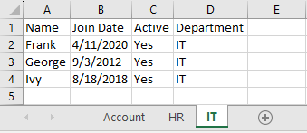
Step 1 : Get data from Employees.csv
Step 2 : Remove inactive employees
Departments.xlsx
Step 3 : Get a list of Account employees
Step 4 : Get a list of HR employees
Step 5 : Get a list of IT employees
Step 6 : Open Departments.xlsx
Step 7 : Write data in Step 3 into worksheet “Account”
Step 8 : Write data in Step 4 into worksheet “HR”
Step 9 : Write data in Step 5 into worksheet “IT”
Name | Join Date | Active | Department
Frank | 2020-04-12 | Yes | IT
George | 2012-09-04 | Yes | IT
Ivy | 2018-08-19 | Yes | IT
Step 10 : Save Departments.xlsx
Step 11 : Close Departments.xlsx

Slide 85

Step 1 : Get data from Employees.csv
Step 2 : Remove inactive employees
Departments.xlsx
Step 3 : Get a list of Account employees
Step 4 : Get a list of HR employees
Save !
Step 5 : Get a list of IT employees
Step 6 : Open Departments.xlsx
Step 7 : Write data in Step 3 into worksheet “Account”
Step 8 : Write data in Step 4 into worksheet “HR”
Step 9 : Write data in Step 5 into worksheet “IT”
Step 10 : Save Departments.xlsx
Step 11 : Close Departments.xlsx

Slide 86

Step 1 : Get data from Employees.csv
Step 2 : Remove inactive employees
Step 3 : Get a list of Account employees
Step 4 : Get a list of HR employees
Close file
Step 5 : Get a list of IT employees
Step 6 : Open Departments.xlsx
Step 7 : Write data in Step 3 into worksheet “Account”
Step 8 : Write data in Step 4 into worksheet “HR”
Step 9 : Write data in Step 5 into worksheet “IT”
Step 10 : Save Departments.xlsx
Step 11 : Close Departments.xlsx

Slide 87
Takeaways
- We can search for VBOs that can help us.
- For example:
We can use VBO “Utility - File Management” to manage files.
We can use VBO “Utility - Collection Manipulation” to handle collections.
We can use VBO “MS Excel VBO” to play around with Excel.
- We can use Action to access VBO actions.

Slide 88
Exercise 3
( Less Comfortable )

Slide 89
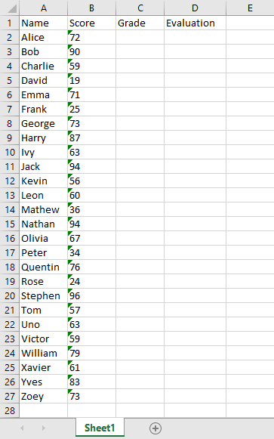
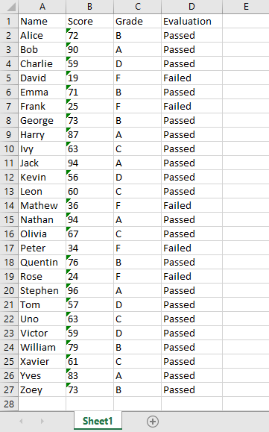
Students.xlsx
Students with Grades.xlsx
If Score is between 80-100, Grade will be “A”.
If Score is between 70-79, Grade will be “B”.
If Score is between 60-69, Grade will be “C”.
If Score is between 50-59, Grade will be “D”.
If Score is between 0-59, Grade will be “F”.
If Grade is “F”, Evaluation will be “Failed”.
Otherwise, Evaluation will be “Passed”.
Save the result as:
Students with Grades.xlsx

Slide 90
Exercise 3
( More Comfortable )

Slide 91
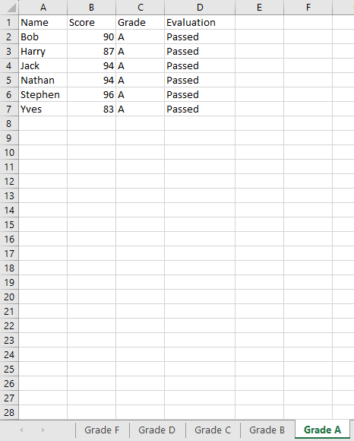
Students.xlsx
Students with Grades.xlsx
If Score is between 80-100, Grade will be “A”.
If Score is between 70-79, Grade will be “B”.
If Score is between 60-69, Grade will be “C”.
If Score is between 50-59, Grade will be “D”.
If Score is between 0-59, Grade will be “F”.
If Grade is “F”, Evaluation will be “Failed”.
Otherwise, Evaluation will be “Passed”.
Separate students based on grade.
Save the result as:
Students with Grades.xlsx

Slide 92
BREAK TIME
14:50 – 15:00

Slide 93
MS Word
VBO
VBO
File Management
Copy Text
Paste Image
Highlight Text
Find Text
Save as PDF
…
Create Directory
Delete Directory
Copy File
Delete File
Write Text File
Move File
…
VBO
MS Excel
Add Row
Delete Row
Add Column
Delete Column
Add Worksheet
…
Decision
Choice
Calculation
Multi Calc
Collection
Loop
…
VBO
Collection Manipulation
Append Field
Filter Collection
Remove Empty Rows
…
MS Outlook Email
Send Email
Reply to Email
Forward Email
Delete Email
Mark Email as Unread
…
VBO
Explore more:
https://digitalexchange.blueprism.com/dx/search

Slide 94
MS Word
VBO
VBO
File Management
Copy Text
Paste Image
Highlight Text
Find Text
Save as PDF
…
Create Directory
Delete Directory
Copy File
Delete File
Write Text File
Move File
…
VBO
MS Excel
Add Row
Delete Row
Add Column
Delete Column
Add Worksheet
…
Decision
Choice
Calculation
Multi Calc
Collection
Loop
…
VBO
Collection Manipulation
Append Field
Filter Collection
Remove Empty Rows
…
MS Outlook Email
Send Email
Reply to Email
Forward Email
Delete Email
Mark Email as Unread
…
VBO
We can create our own VBO !

Slide 95
Create our own VBO

Slide 96
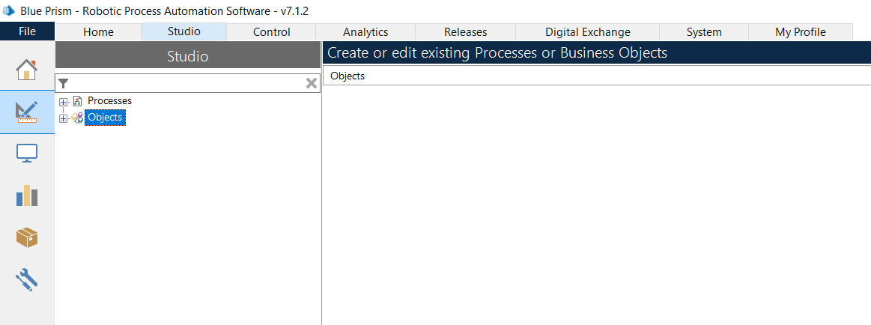

Slide 97
VBO – Google search
Initialise
Clean Up
Google search
Google search in Firefox
Start
…
End

Slide 98
MS Excel
VBO – Google search
Add Row
Delete Row
Add Column
Delete Column
Add Worksheet
…
Initialise
Clean Up
Google search
Google search in Firefox
Start
…
Google search
Google search
Google search in Firefox
…
End

Slide 99
MS Excel
VBO – Google search
Add Row
Delete Row
Add Column
Delete Column
Add Worksheet
…
Initialise
Clean Up
Google search
Google search in Firefox
Start
…
Google search
Google search
Google search in Firefox
…
End

Slide 100
DEMO VBO concept in Blue Prism

Slide 101
Application Modeller

Slide 102
Takeaways
- We can create our own VBO.
- We can use Application Modeller to help us create a VBO.
- Once we completed our VBO, we can publish it and use it in any Process.

Slide 103
Exercise 4
( Less Comfortable )

Slide 104
Stock | Current Price
PTT
ADVANC
SIRI
QH
CPALL
Stock | Current Price
PTT | 33.25
ADVANC | 220.00
SIRI | 1.57
QH | 2.24
CPALL | 55.75
Get stocks prices from the following website:
https://www.set.or.th/th/market/index/set/overview

Slide 105
Exercise 4
( More Comfortable )

Slide 106
Stock | Date1 | Price1 | Date2 | Price2 | Date3 | Price3
PTT
ADVANC
SIRI
QH
CPALL
Stock | Date1 | Price1 | Date2 | Price2 | Date3 | Price3
PTT | 20 ต.ค. 2566 | 33.25 | 19 ต.ค. 2566 | 33.50 | 18 ต.ค. 2566 | 34.00
ADVANC | 20 ต.ค. 2566 | 220.00 | 19 ต.ค. 2566 | 226.00 | 18 ต.ค. 2566 | 225.00
SIRI | 20 ต.ค. 2566 | 1.57 | 19 ต.ค. 2566 | 1.63 | 18 ต.ค. 2566 | 1.65
QH | 20 ต.ค. 2566 | 2.24 | 19 ต.ค. 2566 | 2.26 | 18 ต.ค. 2566 | 2.30
CPALL | 20 ต.ค. 2566 | 55.75 | 19 ต.ค. 2566 | 56.25 | 18 ต.ค. 2566 | 57.25
Get stocks historical prices from the following website:
https://www.set.or.th/th/market/index/set/overview

Slide 107
Code

Slide 108
Pointer
Link
Block
Read
Write
Navigate
Code
Wait
Process
Page
Action
Decision
Choice
Calculation
Multi Calc
Data Item
Collection
Loop
Note
Anchor
End
Alert
Exception
Recover
Resume
The Code allows you to write code supported by .NET.
Start
Loop Start
Choice
Invalid
Invalid Grade
Grade A
Grade A
Grade B
Grade B
Grade C
Grade C
Grade D
Grade D
Otherwise
Grade F
Loop End
End

Slide 109
Pointer
Link
Block
Read
Write
Navigate
Code
Wait
Process
Page
Action
Decision
Choice
Calculation
Multi Calc
Data Item
Collection
Loop
Note
Anchor
End
Alert
Exception
Recover
Resume
The Code allows you to write code supported by .NET.
Start
Loop Start
Choice
Invalid
Invalid Grade
Grade A
Grade A
Grade B
Grade B
Grade C
Grade C
Grade D
Grade D
Otherwise
Grade F
Loop End
End

Slide 110
Pointer
Link
Block
Read
Write
Navigate
Code
Wait
Process
Page
Action
Decision
Choice
Calculation
Multi Calc
Data Item
Collection
Loop
Note
Anchor
End
Alert
Exception
Recover
Resume
The Code allows you to write code supported by .NET.
Start
Code
End

Slide 111
foreach (DataRow row in students_grade.Rows)
{
int score = Convert.ToInt32(row["Score"]);
if (score < 0 || score > 100) {
row["Grade"] = "Invalid";
}
else if (score >= 80) {
row["Grade"] = "A";
}
else if (score >= 70) {
row["Grade"] = "B";
}
else if (score >= 60) {
row["Grade"] = "C";
}
else if (score >= 50) {
row["Grade"] = "D";
}
else {
row["Grade"] = "F";
}
}

Slide 112
END

